Slide 1
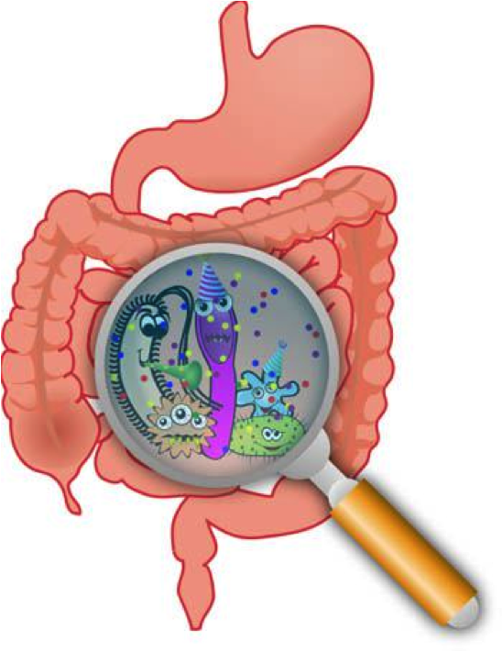
Eating for a Healthy Gut
Notes:
Thank you for attending the session today titled _________________________________. A couple of housekeeping things before we get started.
1. First, this session is being recorded and will be posted on the publically accessible Telehealth portal at firstnatonsTH.ca
2. Second, we ask that you please mute your microphones during the presentation portion of this session. There will be an opportunity for questions at the end. At which point we’ll call out to your individual sites, you can unmute your microphones, ask your questions and re-mute your microphones once again.
With that, I’ll turn it over to our presenter ___________________________ to begin his/her presentation.
Hi, My name is ____________ and I am a dietetic intern working with the nutrition advisory team in the First Nations and Inuit Health Branch, Department of Indigenous Services Canada
Today’s presentation is an example of one of the “Grab n’ Go” presentations that will be made available on One Health for community health providers to use. They will be posted in “kits” that will have the presentation with presenter notes (under the slide), supporting handouts, and activities for group sessions. They are meant to be what they are called, as “Grab n’ Go” resources, meaning that any healthcare worker can do these presentations without having any previous background knowledge on the topics. These presentations can be edited to whatever works best for you, but we do ask that if you make edits that you remove the Government of Canada logo from the slides.
With that being said, lets get started on the topic today, “Eating for a Healthy Gut”

Slide 2
Learning Objectives
To develop an understanding of why the bacteria in our gut are important for our health
To understand the different actions and food sources of pre- and probiotics
To identify three ways to help positively influence gut health
Notes:
My note: The goal for the end of this session is to help you develop a basic understanding of why the bacteria in our gut are important for our health. You will also be learning about pre- and probiotics, to help you develop an understanding of their different actions and food sources. And lastly, by the end of the session, we want you take-away three things that you can do to help positively influence your gut health

Slide 3
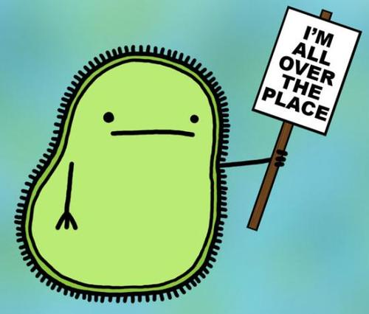
What Makes a Healthy Gut?
The trillions of microorganisms (like bacteria) living in the human gut (intestines)
These microorganisms are called the Gut Microbiota
These microorganisms are important to keep us healthy!
Notes:
So the big question is “what makes a healthy gut?”
To be able to answer this question, we have to understand that there are trillions of microorganisms that live on our skin, in our mouth, our nose, under our nails, on our eyes and our intestines, literally everywhere!
There are actually more of these microorganisms than there are cells in our body, almost 10x more!
Most of them live in the colon, making up the “Gut Microbiota”
The Gut microbiota has such an important influence on our health as these microorganisms literally act as backseat drivers to all the different processes that go on in our body

Slide 4
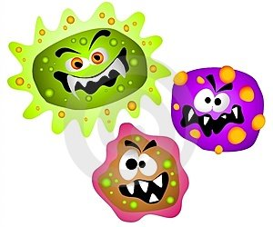
Gut Bacteria
Helps the immune system
Helps to protect us from bad bacteria
Helps with digestion
Unbalanced gut bacteria = increased risk for disease
Notes:
This includes the immune system, where the bacteria in our gut can help it to stay strong and fight off infections.
Helps to protect us from bad bacteria, especially bad bacteria that can grow in our gut
Helps with digestion by helping our gut take in all the nutrients that we need from the foods we eat
In order to for these positive influences to be possible, there has to be a variety and balance of the bacteria that live in our gut
If this bacteria is unbalanced, where there can be more bad bacteria than there is good, it can increase your risk for diseases because it is still driving our bodies processes

Slide 5
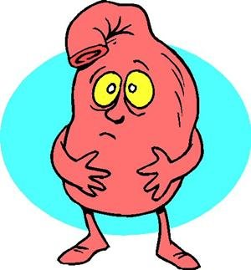
Gut Bacteria
Imbalance is associated with disease:
Colorectal Cancer
Obesity
Diabetes
Allergies
Asthma
Irritable Bowel Syndrome (IBS)
Inflammatory Bowel Disease (IBD)
Notes:
Some diseases have been linked to an imbalance in our gut bacteria:
Colorectal Cancer
Obesity
Diabetes
Allergies
Asthma
Irritable Bowel Syndrome (IBS)
Inflammatory Bowel Disease (IBD)
It is important to recognize that there is still a lot of research being done to see how we can use the gut microbiota to help prevent and treat disease
What we are learning is that...

Slide 6
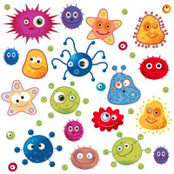
Balance + Diversity = Healthy gut!
Notes:
The balance and diversity of bacteria in our gut keeps the gut healthy, which can help keep us healthy

Slide 7
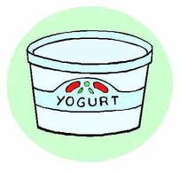
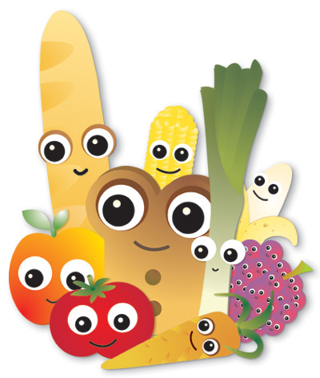
What can affect our gut bacteria?
How we are born
Infant feeding
Antibiotics
Environment
Diet
Notes:
So how do the bacteria in our gut get there in the first place?
There are many different things that can affect the amount and diversity of bacteria in the gut. Each of these factors play a role into the development and diversity of your gut bacteria. For the purpose of today’s presentation, we are going to mainly focus on diet.

Slide 8
What can affect our gut bacteria?
1) How we are born
Affects the first types of bacteria to grow in our gut
2) Infant Feeding
How we are first fed helps to grow bacteria in our gut
Breast milk
Once we are ~ 2-3 years old, we have our “adult” gut bacteria
Notes:
When we are born, our gut does not yet have bacteria. The first few years are when we develop and grow our own personalized gut microbiota.
The way we are born affects the first types of bacteria to grow in our gut.
Infants born by caesarean section have gut bacteria similar to skin, while infants born vaginally have gut bacteria similar to the mothers gut, giving them a great start to their gut microbiota!
How we are first fed helps to foster and grow the bacteria in the gut, where breast milk contains different component that helps to influence the growth of good bacteria in the gut
The bacteria in our gut changes a lot in the first few years of life, but once we are around 2-3 years old, the gut bacteria stabilizes into what will be our own personalized gut bacteria throughout adulthood; this doesn’t mean that we can’t influence our gut bacteria, it just means that it won’t change as dramatically as in the first few years of life

Slide 9
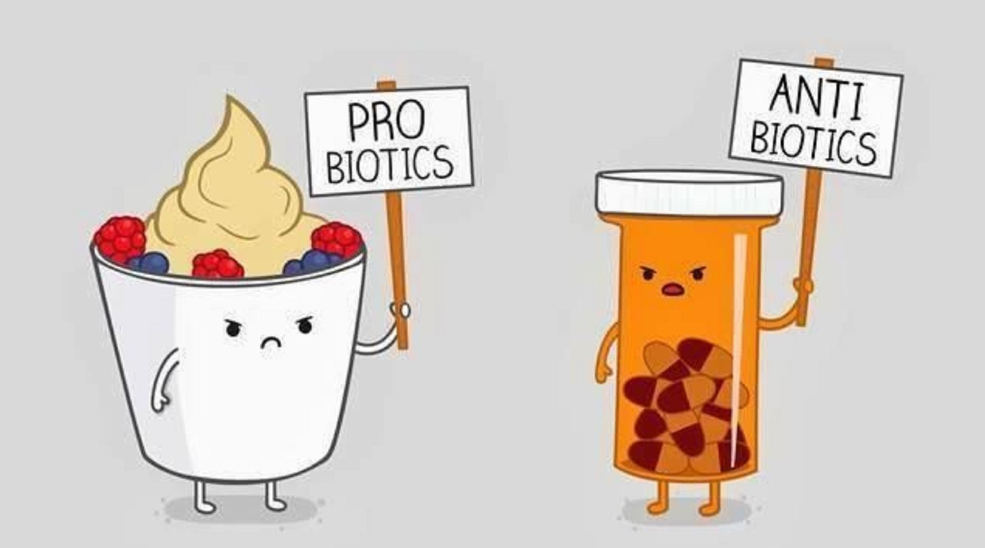
What can affect our gut bacteria?
3) Antibiotics
Can kill the good and bad bacteria
4) Environment
Exposes us to a variety of bacteria throughout our life
Notes:
Antibiotics are a type of medication commonly used to treat a variety of infections. Antibiotics work to kill the bad bacteria, but they also kill some of the good bacteria! Depending on how long you are on antibiotics for, it can take time for the good bacteria to grow back.
The environment that we live in may also affect our gut bacteria. Throughout our life we are exposed to a variety of good and bad bacteria that could impact the types of bacteria in the gut.

Slide 10
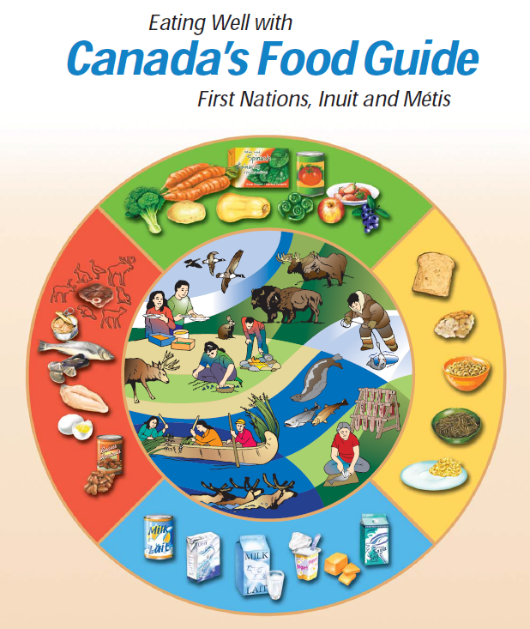
What can affect our gut bacteria?
5) Diet
What we eat impacts our gut bacteria and overall gut health
Food helps to increase the diversity, balance of bacteria in our gut... and so much more!
Specifically, we will look at…
Probiotics
Prebiotics
Notes:
That brings us to diet, where the saying “we are what we eat” comes into effect
As the different foods we eat we select what types of bacteria can grow in our gut
If we eat healthy, we help to make sure that our gut is getting all the nutrients it needs to stay healthy
Depending on what foods we eat, it can help to increase the diversity of bacteria in our gut and keep them balanced for overall health
Specifically, we will take a closer look at how probiotics and prebiotics can influence our gut health

Slide 11
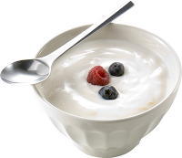
Probiotics
Probiotics are live microorganisms that can be beneficial to the health of the host
Known benefits:
Helps with digestion
Promotes regularity
Improves nutrient absorption
Helps keeps a balance of “good” bacteria in the gut
Notes:
Starting with probiotics,
These are live microorganisms that can be beneficial to the health of the host (our bodies)
Some known benefits of probiotics have included helping with digestion, keeping us regular, improve nutrient absorption, and help keep a balance of “good” bacteria in the gut
When we eat probiotics, they can help with our digestion, keep us regular, and add to the balance of good bacteria in the gut so there is less room for bad bacteria to grow

Slide 12
Probiotic Criteria
In order for microorganisms to be considered a probiotic, they must:
Remain alive during product transport and storage
Be able to survive digestion
Won’t make you sick
Have beneficial effects
Help balance gut microbiota
Help protect against bad bacteria
Notes:
There are specific criteria in order for microorganisms to be called probiotics. Companies can only market a product as having probiotics if:
Be able to survive the digestion process. In other words, when you eat the food with the probiotic, the bacteria must be able to make it all the way from your mouth, through your stomach and small intestine to your colon, where most of the other good bacteria live!
Not toxic (it won’t make you sick)
Remain alive during transport and storage. So that when the product is being moved to the store and to your house, the bacteria are still able to stay alive in amounts that are still going to be helpful to your body
Have beneficial effects
Help balance gut microbiota
Help protect against bad bacteria

Slide 13
Notes:
This is just a cartoony example of how the probiotics help to protect us from bad bacteria
The walls of the gut have a limited amount of space for bacteria to “settle-in”. One suggested mechanism for how probiotics help to protect us against bad bacteria is that they line the wall of the gut to keep bad bacteria from sticking around.

Slide 14
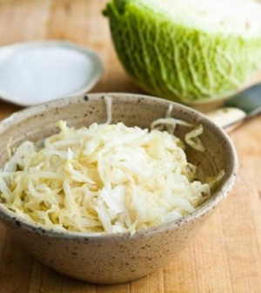
Probiotic Products
Probiotics come in a variety of forms:
Supplements
Naturally occurring in food
Added to food products
Note: Probiotics must be taken regularly for any benefits to continue
Notes:
Probiotics come in a variety of forms, including:
Supplements; read the label
Food
Naturally occurring or added to the food product
Natural foods that have probiotics have gone through a process called fermentation. Fermentation happens when a bacteria or yeast breaks down the food product in an environment with no oxygen. As it breaks down the food, the bacteria usually produce an acid, which is why fermented foods taste sour, like sauerkraut.
As I previously mentioned, yogurt can be a probiotic if live cultures have been added to it after processing.
An important thing to note that any form of probiotics have to be taken regularly to maintain any benefits, since the probiotic bacteria do not keep growing in the gut and are “flushed” out with the renewing of the cells in our gut.

Slide 15
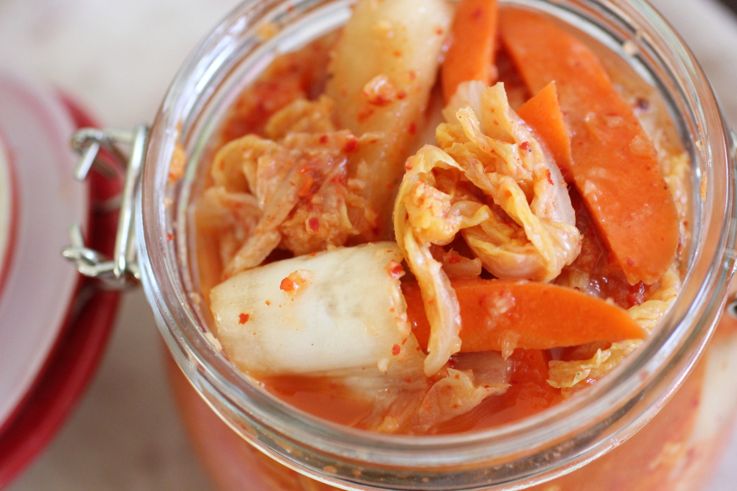
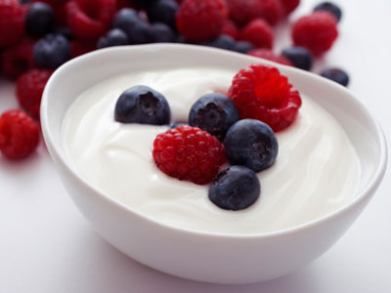
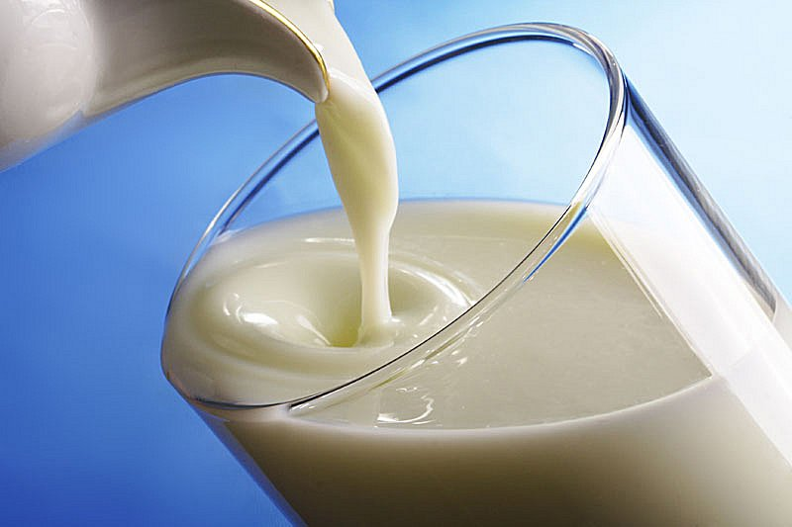
Foods with Probiotics
Naturally containing:
Sauerkraut
Kimchi
Kefir
Sometimes added to:
Yogurt
Check label for “live cultures”
Kefir
Kimchi
Yogurt
Notes:
More examples of naturally fermented foods include kimchi and kefir, as shown at the bottom of the slide. Kimchi is a lot like sauerkraut, but originates from Korea and is made with different spices. Kefir is a type of fermented milk, originating from Russia. These foods are all naturally fermented, and can contain many different types of bacteria.
These products can act as probiotics, but there are two things to keep in mind:
Also, not all fermented foods contain enough live bacteria to be helpful to our gut health.
Some of these products sold in stores, like sauerkraut and kimchi, are made with vinegar instead of being naturally fermented and are processed at a very high heat, killing any of the live good bacteria. If you are looking at purchasing these products for a probiotic benefit, look for “live cultures” on the ingredients label.
Specific probiotic bacteria are often added to foods like yogurt
Pay attention to the amount of salt and sugar added to these products. While they do contain bacteria that are good for our gut health, they can often contain a lot of salt and sugar that is not good for our overall health!
Plain yogurt is a good choice of probiotic food because it has lots of nutrients that are healthy for our body (calcium, vitamin D) and it does not have added sugars. This way you can add your own fruit for flavor to control the amount of extra sugar.

Slide 16
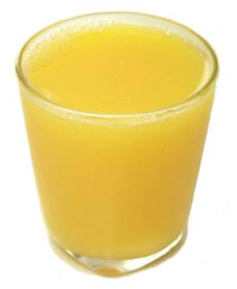
Buyer Beware
Not all foods with added probiotics are healthy choices
Companies may add probiotics to help market their product
Notes:
With that being said, not all foods with added probiotics are healthy choices. A good example is that probiotics are sometimes added to juices. Companies do this to help market their product.
Juice is not recommended as a healthy beverage choice and should be limited to ½ cup of 100% pure fruit juice in a day.
This is because:
Juice is a source of simple sugars (sugar that is already broken down for absorption). This means that it can quickly enter our blood stream and increase our blood sugar levels
Can be high in calories (or energy) that won’t be registered by our brains. This means that because it doesn’t take a lot of effort to get into our bodies (i.e. doesn’t require a lot of chewing and is quickly absorbed), our brain isn’t told that we had taken in some energy and won’t know to adjust our hunger.
Now that we know what probiotics are, what about prebiotics and their role?

Slide 17
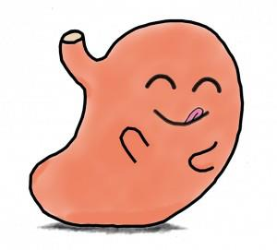
Prebiotics
Prebiotics are non-digestible foods that help the growth of bacteria in the gut
Known benefits:
Helps feed good bacteria in the gut
Helps good bacteria grow in the gut
Helps with constipation (keeps us regular)
Notes:
Prebiotics! These are non-digestible food ingredients that help the growth of good bacteria in the gut
They are also called the “food” for probiotics
It is known that the prebiotics in food help to feed good bacteria in the gut, which help good bacteria grow and multiply
Prebiotics can also help with constipation

Slide 18
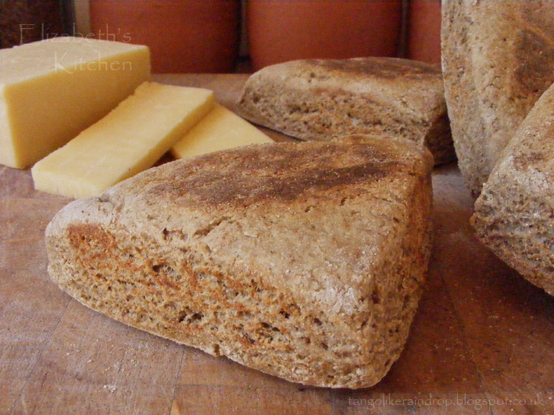
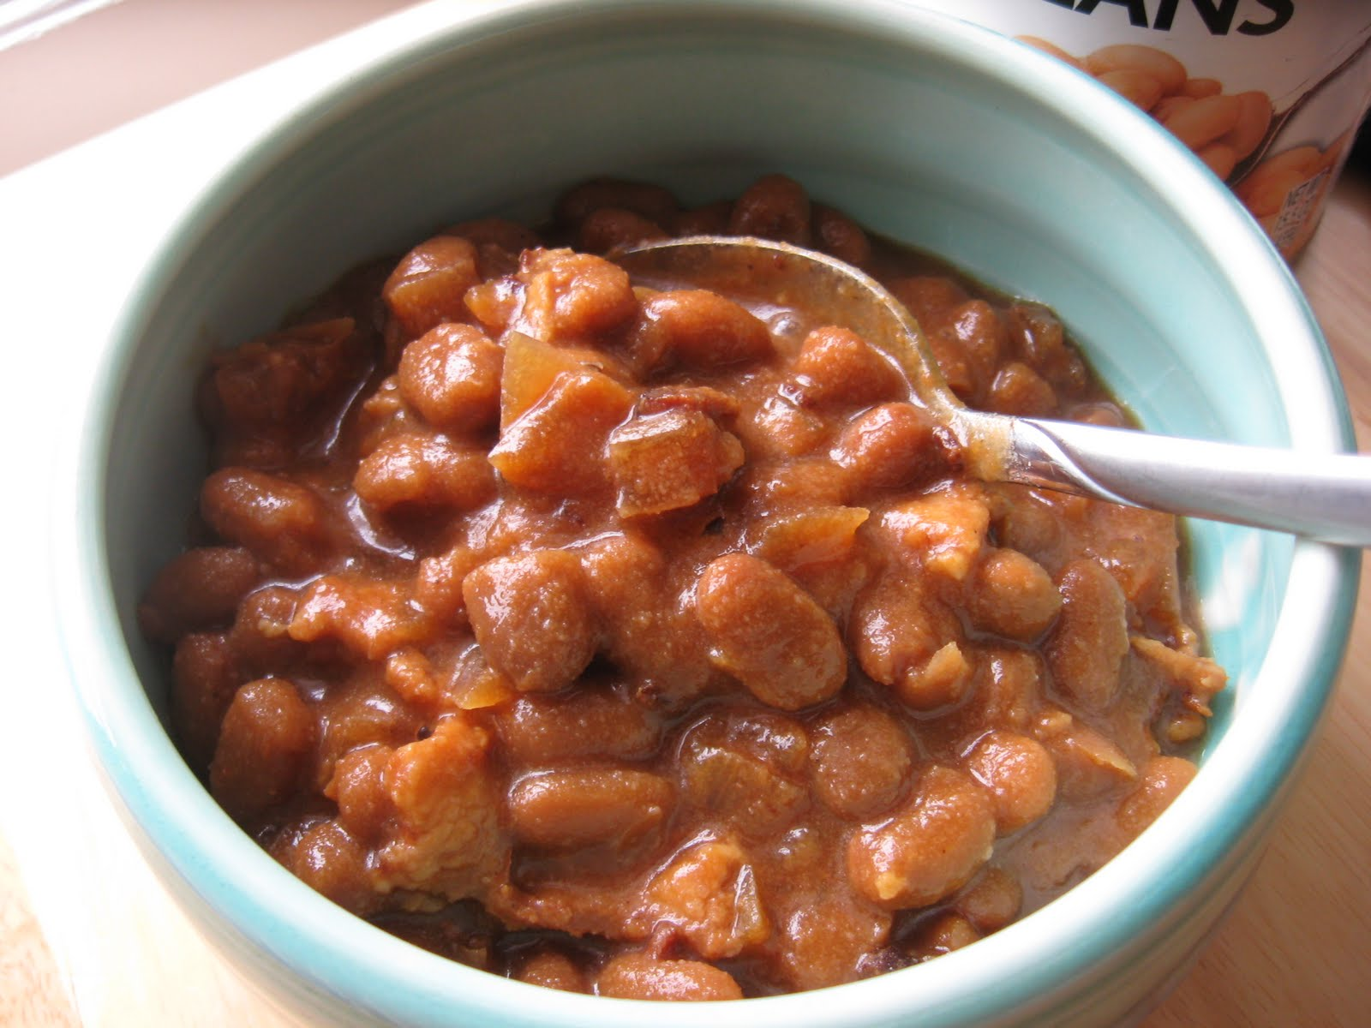
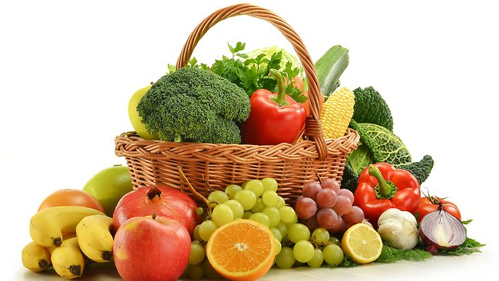
Prebiotics
Often found in high fibre foods, like:
Whole grains
Barley, rye and buckwheat
Fruits and vegetables
Bananas, onions and garlic
Legumes
Lentils, chickpeas and kidney beans
Note: an increase in fibre means an increase in fluid
Notes:
Prebiotics are found in high fibre foods, which is why they can help with constipation.
Prebiotics are also found in foods such as whole grain foods and fruits and vegetables like onions, garlic, leeks and soybeans
They are food components such as inulin, pectin, resistant starch, and oligosaccharides, which is the component in breast milk that helps to feed the good gut bacteria

Slide 19
So... What’s the difference between probiotics in food vs supplements?

Slide 20
Probiotics in Food
Benefits | Downside
Provides other nutrients Example: Calcium and protein with yogurt Can provide both pre- and probiotics Example: Cabbage in Sauerkraut | Only certain foods have probiotics May not be able to tolerate yogurt with lactose intolerance *Note: You can get lactose-free yogurt
Notes:
Benefits to food sources of probiotics include:
- The other nutrients that the food source provides, like calcium and protein in probiotic yogurt
Since it is a food source, it can provide both pre- and probiotics. A good example of this is cabbage, as the fibre in cabbage acts as a food source for the probiotics in Sauerkraut
Downsides to probiotics in food include:
Only certain foods have probiotics, limited selection to choose from
Some people may find that they experience bloating or constipation if they eat too much yogurt or milk products. This might mean that there is a lower amount of the enzyme lactase around to digest the sugar lactose in these products, known as lactose intolerance. Fortunately, there are lactose-free products around, such as a lactose-free yogurt. Check the label to make sure that these products have added cultures to be considered probiotics.

Slide 21
Probiotics in Supplements
Benefits | Downside
May have a greater number and variety of microorganisms Example: VSL #3 May be beneficial for specific conditions Example: Ulcerative colitis | Doesn’t have other nutrients that food sources would provide Expensive Evidence??
Notes:
Benefits to probiotic supplements include:
Some types of supplements may provide a greater number and variety of microorganisms that could be beneficial for certain conditions. An example would be VSL#3 for patients with ulcerative colitis as this condition only affects the colon, where majority of our microorganisms live
If you would like to use probiotic supplements for a certain condition, it is important to check the evidence for which strain(s) could be helpful. You can always talk to your doctor if you wanted to learn more about taking probiotic supplements for a certain condition.
Downsides to probiotic supplements include:
That they won’t provide the same nutritional benefits you would retain from food sources, such as prebiotics and other vitamins and minerals
Can be expensive and can add up in cost as probiotics have to be taken daily to keep living in your gut and continue their effect.
Even though there is a large amount of evidence emerging on these probiotics, there is still more research needed to understand the types of bacteria, dosage, and sources that are most beneficial for health. Keep this in mind if you are interested in purchasing supplements; it is important to label read to know what is in the product you are purchasing.
Remember, everyone has a different gut microbiota, so there is no guarantee that one type of probiotic will be as helpful for everyone.

Slide 22
Healthy Eating Everyday
Will help keep you and your gut healthy:
Energy and nutrients from healthy foods will feed you and your “good” gut bacteria
More realistic for including pre- and probiotics in everyday life
Notes:
What do we know?
Healthy eating everyday is helpful for everyone in keeping both themselves and their guts healthy.
- The energy and nutrients from healthy foods will feed you and your “good” gut bacteria
- It may be more realistic to include pre- and probiotics in your everyday eating patterns as this can be a cheaper alternative to supplements while providing the additional benefits of foods that you need for your overall health

Slide 23
Test your knowledge!
3 Minute Activity
At each site...
Work together to group foods (on the next slide) as either:
Probiotics
Prebiotics
Neither
Notes:
On the next slide, there are pictures of different foods that can be grouped as probiotics, and/or prebiotics or neither
As groups at each of your sites, take the next 3 minutes to work together to group the foods in the correct categories

Slide 24
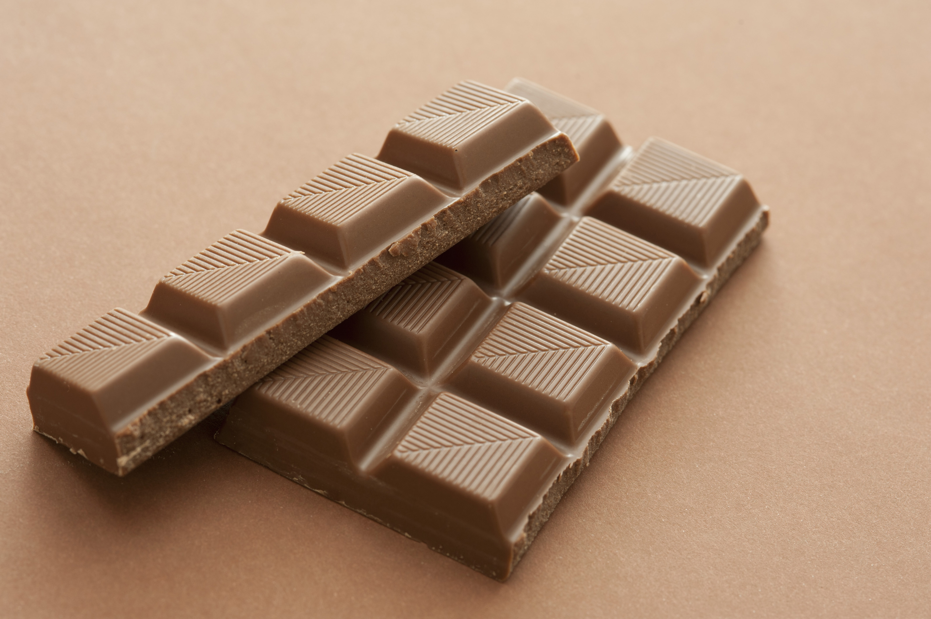
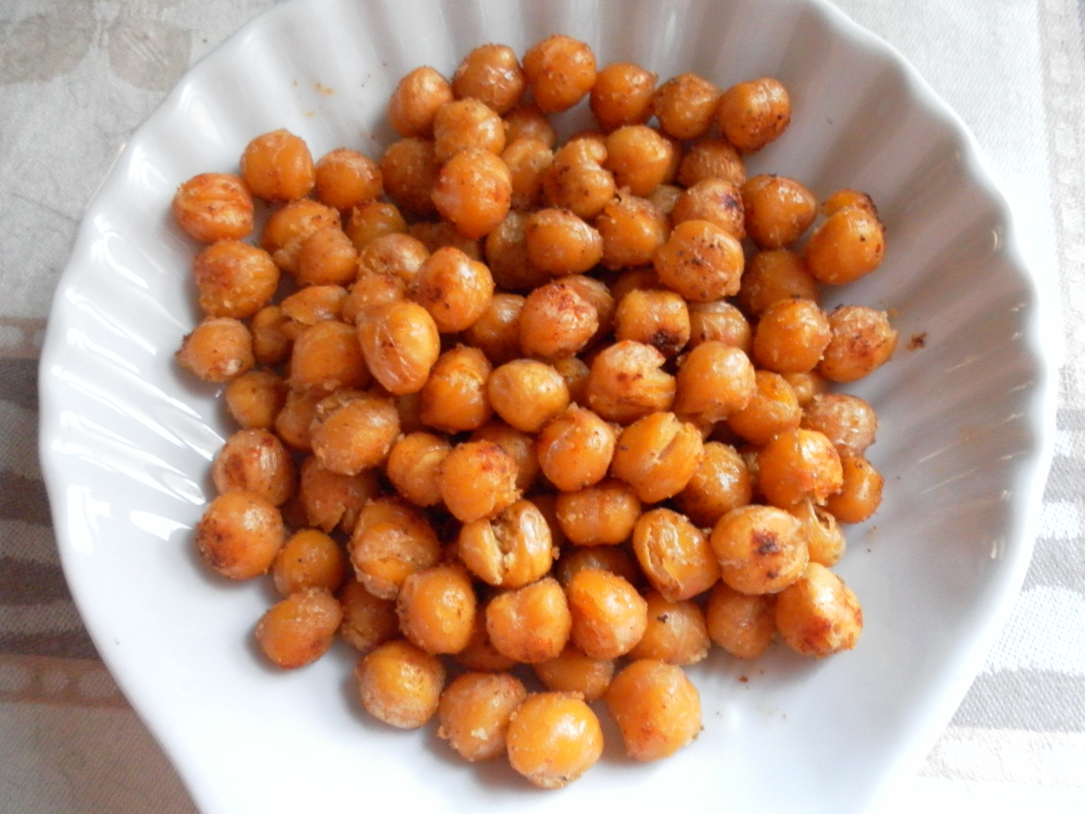
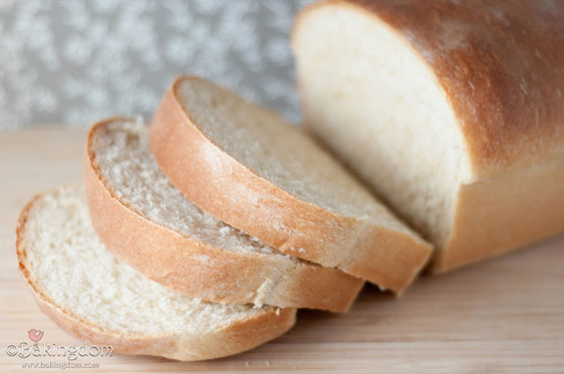
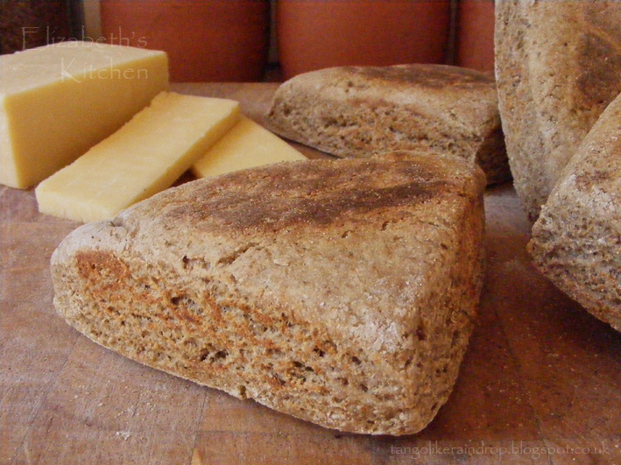
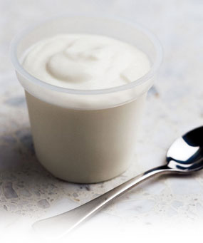
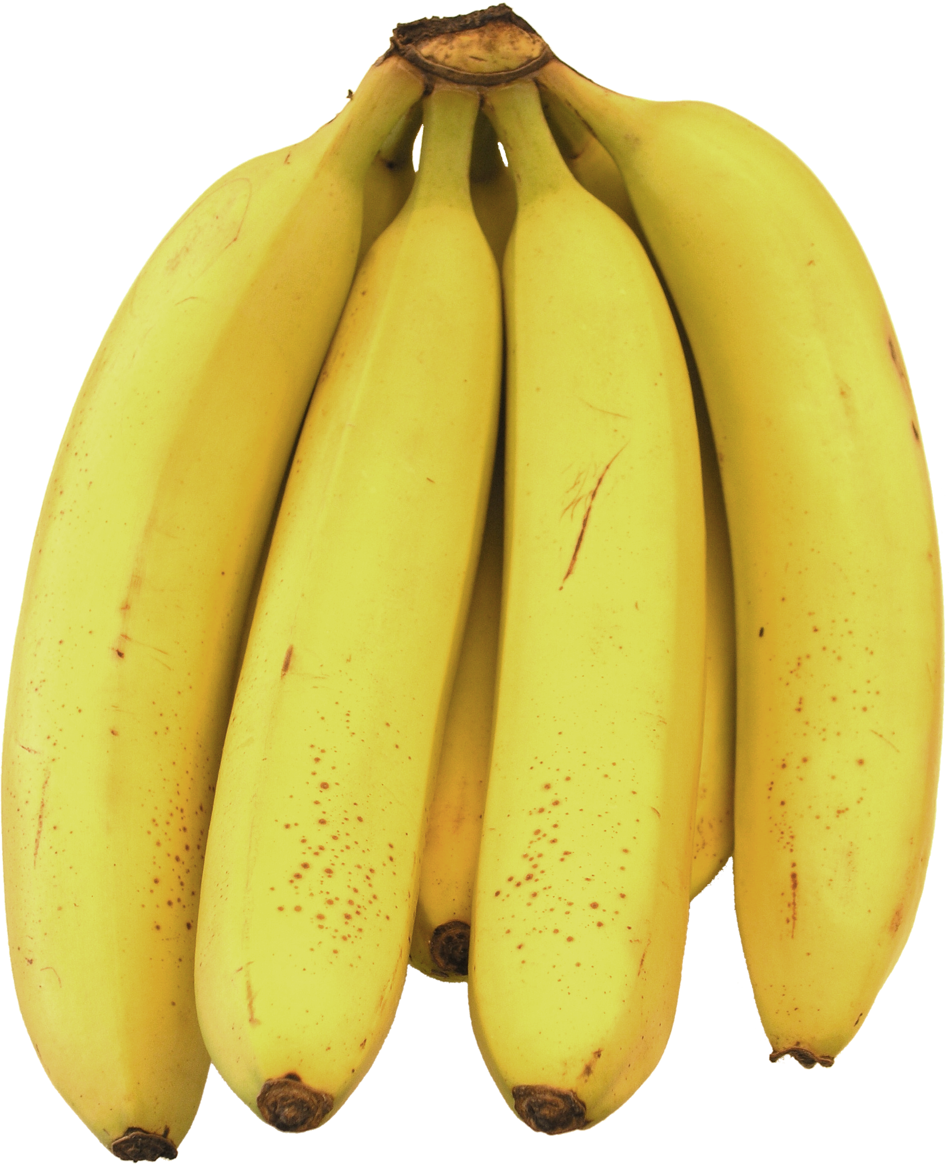
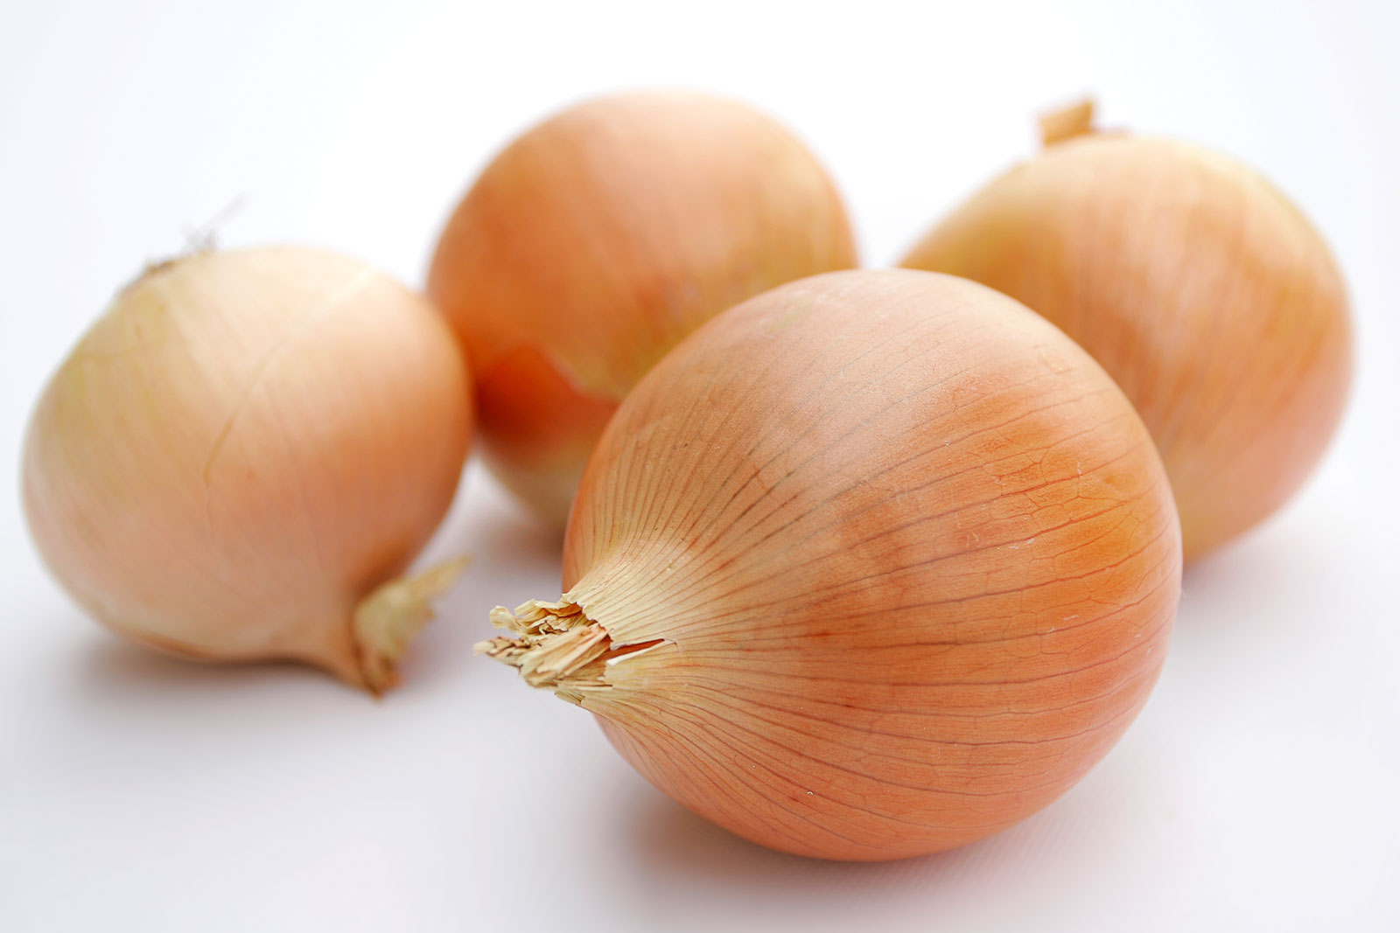
Probiotics, Prebiotics, or Neither?
Chocolate
Chickpeas
Kimchi
White Bread
Whole Wheat Bannock
Yogurt
Bananas
Onions
Notes:
Go!
Time is up! I hope that you all had some interesting discussion amongst yourselves.
I am going to pull up the answers on the next slide, and I will call on each site and ask if you had the same answers or if not, why you grouped things differently.

Slide 25
Probiotics | Prebiotics | Neither
Kimchi
Whole Wheat Bannock
Chocolate
White Bread
Onions
White Bread
Yogurt (live cultures)
Bananas
Yogurt (no added cultures)
Chickpeas

Slide 26
What can we do to keep our gut healthy?
1) Feed your “good” gut bacteria with fibre
Choose whole grains, vegetables, fruits and legumes
2) Increase in fibre = increase in fluids
Drinking healthy fluids over the day helps to keep foods moving through the gut
3) Feed your gut everyday with “good” bacteria
Example: as a snack, have ¾ cup of yogurt (with live cultures) with a piece of fruit (like a banana)
Notes:
In summary of what we talked about, the three take-aways of today for what you can actually do to keep your gut healthy are:
Feed the good gut bacteria, in other words, eat prebiotics, including high fibre foods. Not only do these foods help to feed the good gut bacteria, they also help to keep you regular. Breastfeeding is important to help feed the good bacteria in infant’s gut
Drink lots of water. As you increase your fibre intake it is important to also increase your water intake to help your body move the fibre through
Add in extra “good” bacteria. Eating a probiotic food each day such as yogurt can help keep your gut full of good bacteria, and keep the bad ones out!
If you decide that you want to start trying introducing these tips into your everyday life, just remember to start slow.
Let your gut get used to the changes you’re making by eating probiotic foods or high fibre foods in small amounts each day.
This will allow for new “good” bacteria to colonize your gut.

Slide 27
Thank You! Questions?

Slide 28
Eating for a Healthy Gut – Overview Microbiota video:
http://cdhf.ca/en/videos/introducing-the-human-gut-microbiome
Notes:
Do we want to show video at the end to reinforce what we have learned or after learning objectives? Or is it necessary at all?

Slide 29
For More Information
Gut Microbiota
http://www.gutmicrobiotaforhealth.com/en/home/
http://cdhf.ca/en/staying-healthy/your-microbiota/section/about
http://loveyourtummy.org/
http://www.probioticchart.ca/
Probiotics/Prebiotics
http://cdhf.ca/en/staying-healthy/pre-probiotics/section/resources
http://cdhf.ca/bank/document_en/72understanding-probiotics-.pdf#zoom=100
http://cdhf.ca/en/videos/pre-and-probiotics
http://uat.eatrightontario.ca/en/Articles/Probiotics/prebiotics/Prebiotics.aspx
http://www.eatrightontario.ca/en/Articles/Digestion/The-Pros-of-Probiotics.aspx
Notes:
If you are interested in learning more about your gut microbiota and probiotics and prebiotics, these are a few links to some helpful websites!

Slide 30
References
Azad, M. B., Konya, T., Maughan, H., Guttman, D. S., Field, C. J., Chari, R. S. ... & Kozyrskyj, A. L. (2013). Gut microbiota of healthy Canadian infants: profiles by mode of delivery and infant diet at 4 months. Canadian Medical Association Journal, 185(5), 385-394. doi: 10.1503/cmaj.121189.
Chilton, S. N., Burton, J. P. & Reid, G. (2015). Inclusion of fermented foods in food guides around the world. Nutrients, 7(1), 390-404. doi:10.3390/nu7010390
Clemente, J. C., Ursell, L. K., Wegener Parfrey, L. & Knight, R. (2012). The impact of the gut microbiota on human health, an integrative view. Cell, 148(6), 1258-1270.
Douglas, L.C. & Sanders, M. E. (2008). Probiotics and Prebiotics in Dietetics Practice. Journal of the American Dietetic Association, 108(3), 510-521. http://dx.doi.org/10.1016/j.jada.2007.12.009.
Huff, B. A. (2004). “Probiotics” might not be what they seem. Candadian Family Physician, 50, 583-7.
Krumbeck, J. A., Maldonado-Gomez, M. X., Ramer-Tait, A. E. & Hutkins, R. W. (2016). Prebiotics and synbiotics: dietary strategies for improving gut health. Current Opinion, 32(2), 110-119. doi: 10.1097/MOG.0000000000000249
Marco, M. L, Heeney, D., Binda, S., Cifelli, C. J., Cotter, P. D., Foligne, B. … & Hutkins, R. (2017). Health benefits of fermented foods: microbiota and beyond. Current Opinion in Biotechnology, 44, 94-102. https://doi-org.uml.idm.oclc.org/10.1016/j.copbio.2016.11.010
Practice Based Evidence in Nutrition (2016). Gastrointestinal system- Microbiota background. http://www.pennutrition.com/KnowledgePathway.aspx?kpid=24357&trid=25391&trcatid=38
Sanders, M. E., Guarner, F., Guerrant, R., Holt, P. R., Quigley, E. M., Sartor, R. B., Sherman, P. M. & Mayer, E. A. (2013). An update on the use and investigation of probiotics in health and disease. Gut, 62(5), 787-796. doi: 10.1136/gutjnl-2012-302504.
Tamang, J. P., Shin, D., Jung, S. & Chae, S. (2016). Functional properties of microorganisms in fermented foods. Fermented Foods, 7(578). doi: 10.3389/fmicb.2016.00578
Wallace, T. C., Guarner, F., Madsen, K., Cabana, M. D., Gibson, G., Hentges, E. and Sanders, M. E. (2011), Human gut microbiota and its relationship to health and disease. Nutrition Reviews, 69: 392–403. doi:10.1111/j.1753-4887.2011.00402.x

